Slide 1
A warm up question for you...

Slide 2
Mark scheme

Slide 3
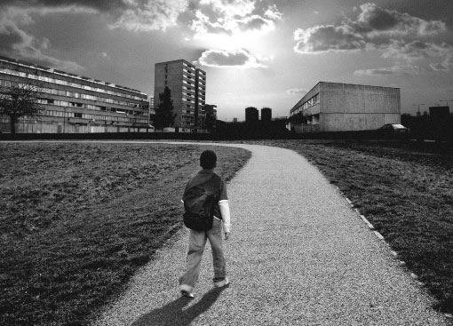
Urban Deprivation and Regeneration

Slide 4
Learning Outcomes:
All of us will be able to identify examples of urban deprivation
Most of us will be able to compare deprivation in two areas
Some of us will be able to create an A* exam answer

Slide 5
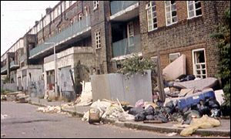
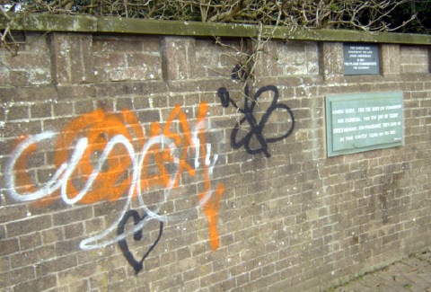
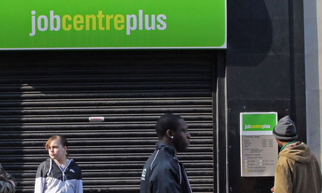
What signs of urban deprivation can you spot?

Slide 6
Write down 3 pieces of evidence that prove that the Survey area is deprived

Slide 7
How can deprived areas be improved?
Use your notes or the textbook to create a case study summary table
Area | What were the problems beforehand? | What were the social improvements | What were the economic improvements | What were the environmental improvements

Slide 8
Applying our Knowledge:
Describe and explain how a redevelopment project could improve the quality of life in a deprived area? [6 marks]
Adapted from June 2011 Q2e

Slide 9
how would you turn this into an a* answer?
Litter collection and recycling systems could improve the quality of life in a deprived area because it would make the environment look nicer.
Another way in which the area could be improved would be to install street lighting and security cameras in the area. This would improve safety.

