Slide 1
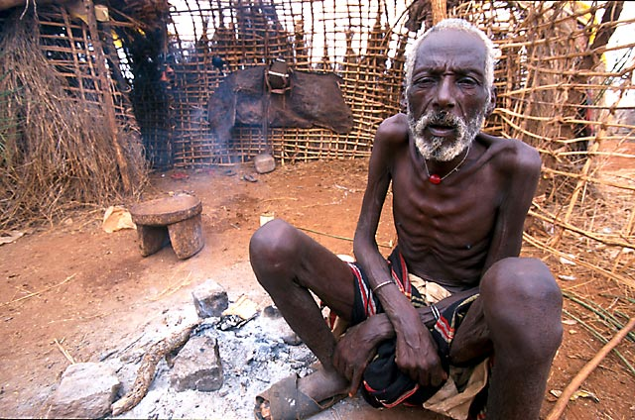
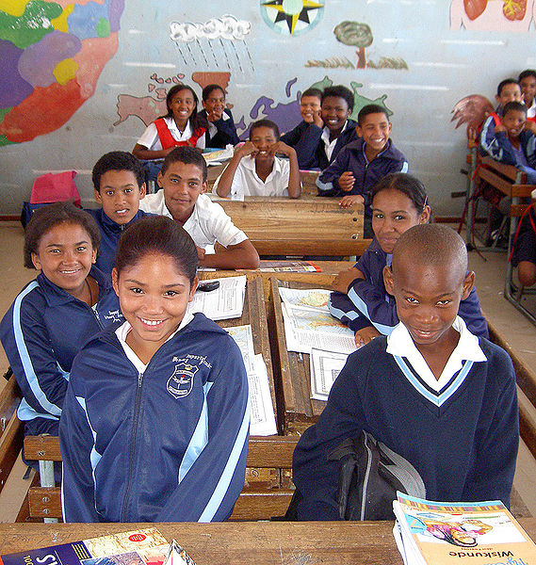
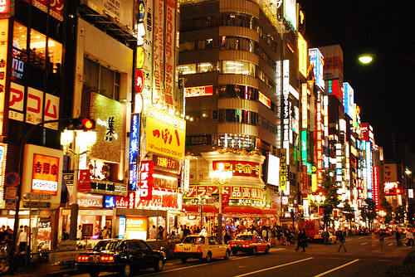
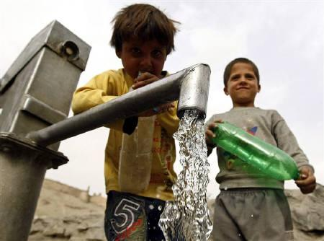
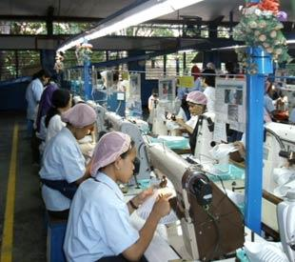
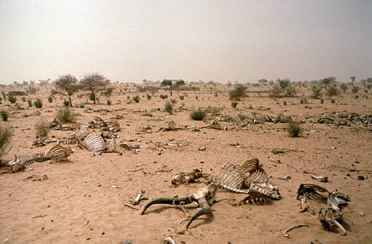

Slide 2
Why are people moving to urban areas?

Slide 3
Using examples, explain how urban growth increases environmental hazards. [8 marks]
Hazard + explanation = Example/specific detail(s) = L3
p.38-39
Power Terms?

Slide 4
Using an example, explain how the urban environment may be improved. [8 marks]
Strategy + explanation = Example/specific detail(s) = L3
Curitiba
p.38-39
Power Terms?

Slide 5
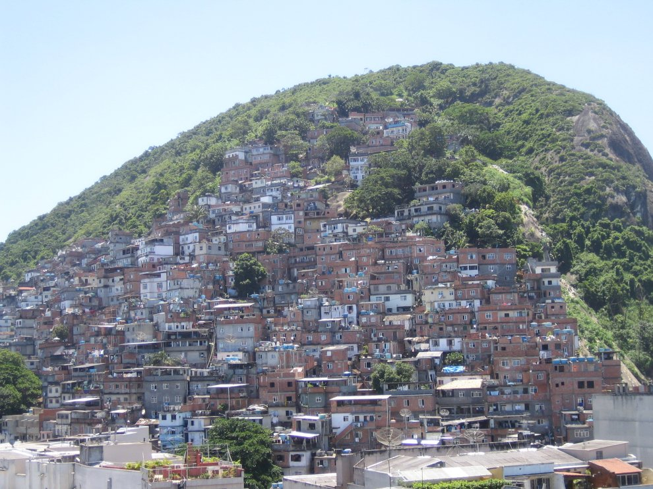

Slide 6
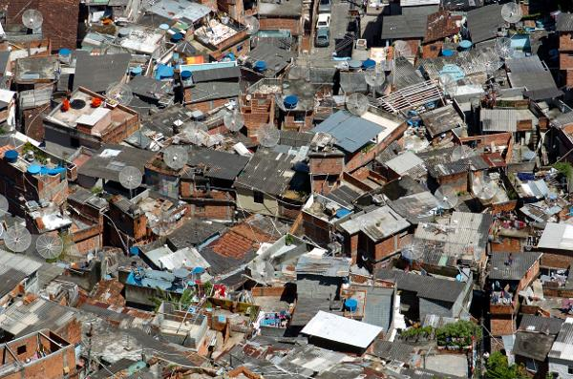

Slide 7
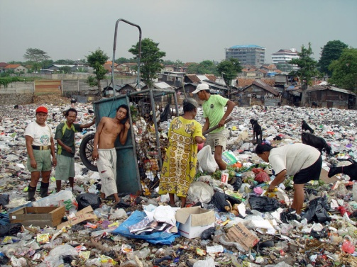
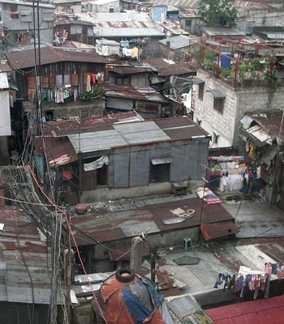
Exam Question
Many people who move to cities in LEDC’s end up living in conditions like those shown in the pictures.
How might the conditions shown in the pictures affect people’s quality of life? [5]
Beginning | Connective | Connected point
People in shanty towns have no access to clean water… | which means that…
People in slums do not have many job opportunities… | this is because…
There is a lot of rubbish in the streets and open sewers… | which causes…

